Slide 1
Aim :
To check whether the Weight of the fish is dependent on various factors like Vertical Length, Diagonal Length, Cross Length, Height and Diagonal Width.

Slide 2
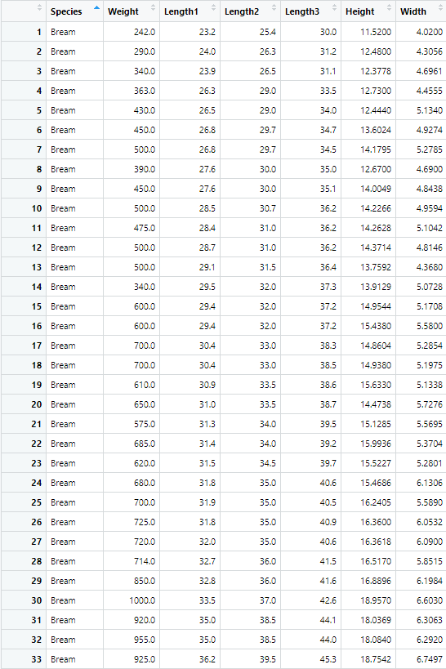
Dataset :
The dataset used is a record of 7 different fish species in fish market sales.
The columns in the dataset includes Species name of fish, Weight of fish in gram, Vertical Length in cm – Length1, Diagonal Length in cm – Length2, Cross Length in cm – Length3, Height in cm and Diagonal Width in cm.
The data contains 159 observations for 7 variables out of which 1 is qualitative variable and other 6 are quantitative variables.

Slide 3
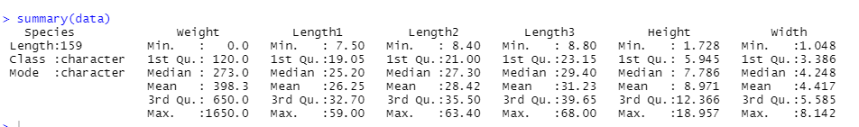
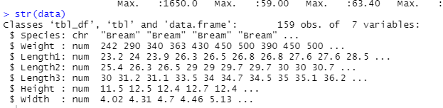
Descriptive Statistics :
summary() function gives us the minimum value, 1st Quartile, Median, Mean, 3rd Quartile and maximum value for all numeric variables in the dataset.
str() function gives the structure of the dataset & helps us in knowing the datatype of the variables.

Slide 4
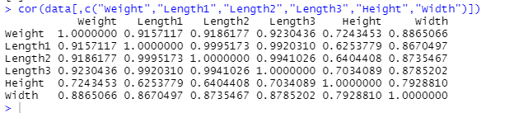
cor() function gives the correlation coefficient value between two variables. Here, I have used it to find correlation between the dependent variable and all independent variables.
Here, the correlation coefficient values are greater than 0.5, which indicates that the variables are highly correlated.

Slide 5
Fitting the Model :
model=lm(y~x1+x2+…+xn) function fits a linear model, where y acts as a dependent variable and xi’s act as an independent variables.
Here, the Weight is the dependent variable and Length1, Length2, Length3, Height and Width are independent variables
summary(model) gives the Adjusted R-square value and the p-value, which helps us in determining whether the model is a good fit for the data or not.

Slide 6
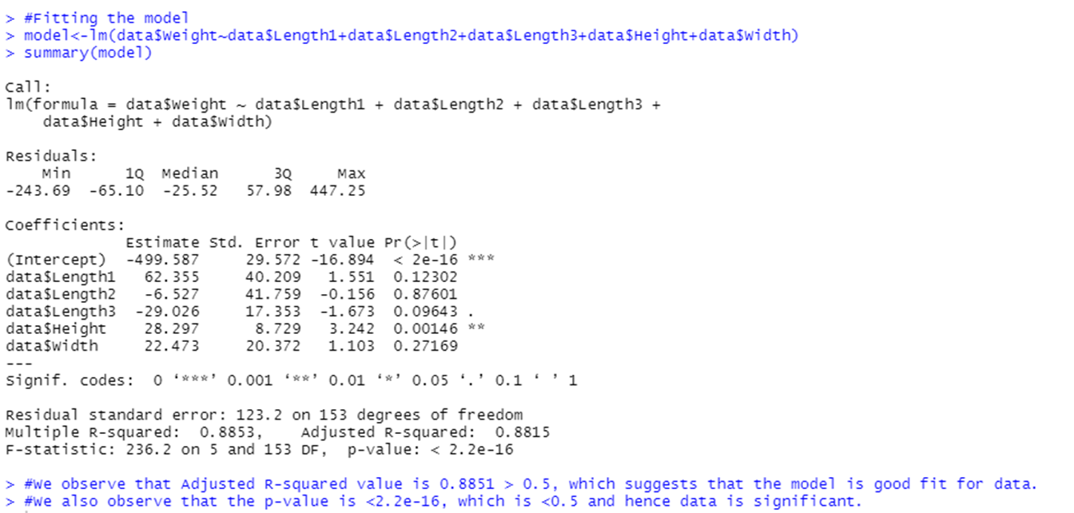

Slide 7
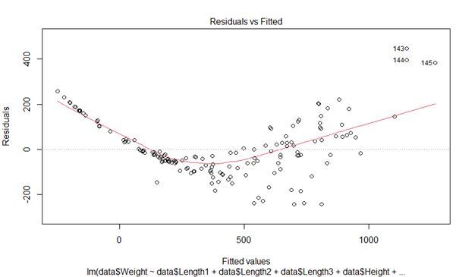
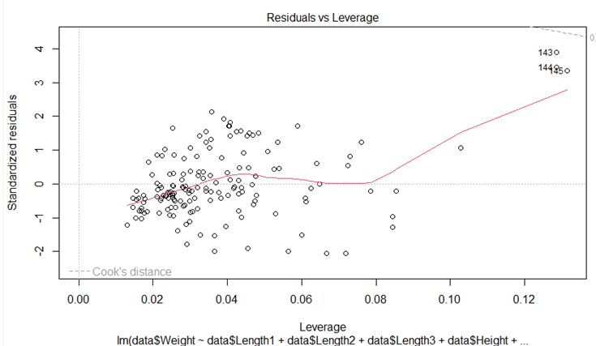
Plots :
From the Residual vs Fitted graph, we can conclude that we have non-linear relationship, since we do not find equally spread residuals around horizontal line.
From the Residual vs Leverage graph, we tend to look for outliners at the upper right or lower right corners. Here our data has some outliners.

Slide 8
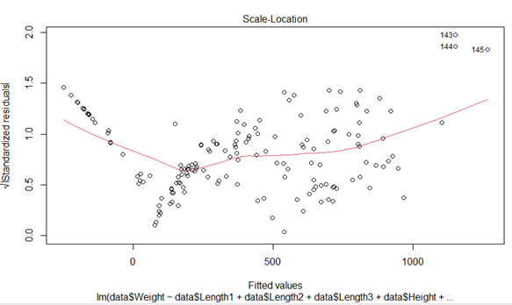
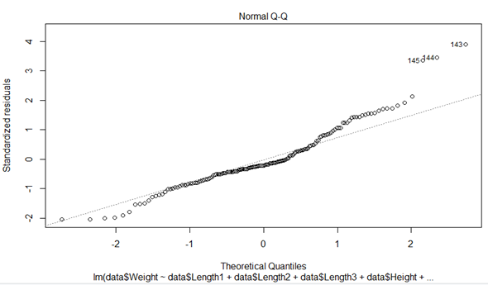
From Scale-Location graph, we check the assumption of equal variance (Homoscedasticity). Since we are unable to locate a horizontal line, homoscedasticity is present.
From Normal Q-Q plot, we can conclude the residuals are not normally distributed since the observations are deviating at the end.

Slide 9
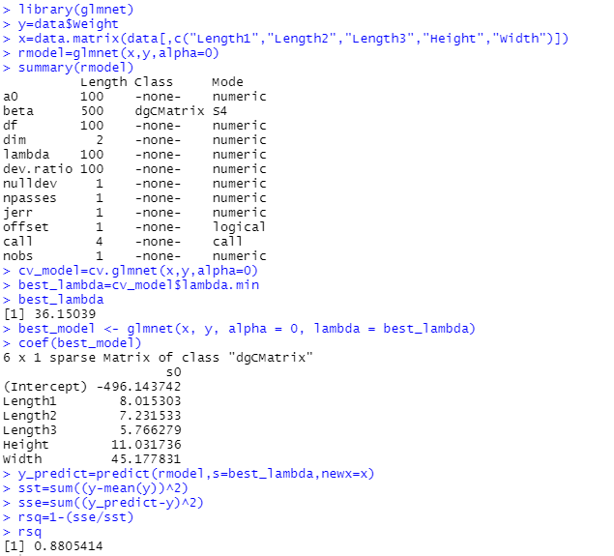
Ridge Regression :
Since the variables Length1, Length2 and Length3 are highly correlated (>0.9), multicollinearity is present in the data and hence we can go for Ridge Regression.
We use the library glmnet() to perform Ridge Regression. Then depending on the lambda and alpha values, we have fitted a new model with R-square value as 0.88

Slide 10
Thank You !!!

